Slide 1
French and Indian War
The “Real” First World War
Also known as the Seven Years’ War, this New World conflict marked another chapter in the long imperial struggle between Britain and France. When France’s expansion into the Ohio River valley brought repeated conflict with the claims of the British colonies, a series of battles led to the official British declaration of war in 1756.
Notes:
Document Based Questions (DBQ) for SS.8.20 Explain the role of western Virginia in the French and Indian War
Click on Title to view video
According to the video, why do you think this is referred to as the first world war.
Short paragraph, exit slip, think pair share

Slide 2
At the end of this unit, you will be able to:
Compare and contrast the four opposing viewpoints in the Ohio River Valley during the French and Indian War.
You are responsible for knowing
The four groups
Why they were fighting
How did the geography of the area contribute to the conflict
What was the outcome
You will incorporate all of this information into your final writing assignment.
Notes:
At the end of this unit students
Rubric
The War's over! As a colonist, tell us how you feel about the British, the French, and The Indians and why.

Slide 3
The four factions involved in this conflict were:

Slide 4
NATIVE AMERICANS
Indian Point of View:
A lifestyle to protect --The American Indians had a strong trading relationship with the French, as well as the British. In addition to wanting to maintain their way of life in the Ohio Valley, the Indians had become dependent on European goods like weapons, rum, metal tools and cloth, and needed to protect their trade relationships.

Slide 5
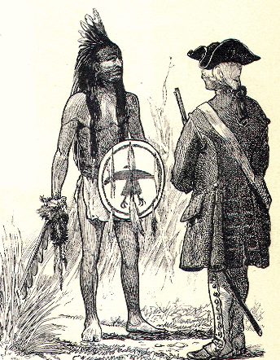
NATIVE AMERICANS
Englishman, although you have conquered the French, you have not yet conquered us! We are not your slaves. . . .
Englishman, our father, the King of France, employed our young men to make war upon your nation. In this warfare many of them have been killed, and it is our custom to retaliate until such time as the spirits of the slain are satisfied. But the spirits of the slain are to be satisfied in either of two ways; the first is by the spilling of the blood of the nation by which they fell; the other by covering the bodies of the dead, and thus allaying the resentment of their relations. This is done by making presents.
Englishman, your king has never sent us any presents, . . . wherefore he and we are still at war; and until he does these things we must consider that we have no other father, nor friend among the white men than the King of France. . . . You do not come armed with an intention to make war. . . . We shall regard you, therefore, as a brother. . . . As a token of our friendship we present you with this pipe to smoke.
Minavavana, a Chippewa chief, addressing trader Alexander Henry, as recorded by Henry, 1761

Slide 6
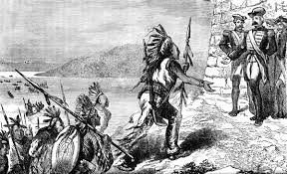
However, the Native Americans were not known to stay loyal to any one side. Do you believe that the Native Americans were straddling the fence between the two kings?
The Half King Must Make A Choice

Slide 7
THE FRENCH
French Point of View Regarding the War:
Trade is everything--Trade with the American Indians is the basis of France’s North American economy, and they think British trade and settlements are encroaching on this. In order to protect the Ohio Valley for trade, the French build forts in the Valley to try to expel British traders.

Slide 8
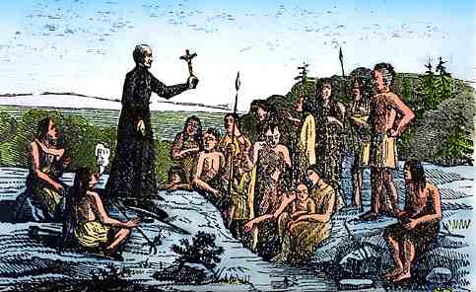
Many of the first French settlements in North America were by a French sect of the Roman Catholic Church called the Jesuits. Their main purpose was to convert the Native Americans to Christianity.

Slide 9
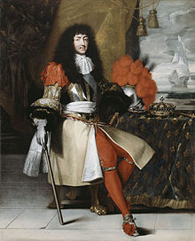
The use of Christianized Indians to carry out the war against the English frontier settlements was a matter of French crown policy. It was understood by the officials at Versailles that in most cases the movement of war-parties throughout the frontier were generally first ordered or sanctioned or suggested by King Louis XIV himself. It was widely believed by English settlers that the Jesuits of New France actively incited the Indians against the English settlements because of their Protestantism. The missionaries were accused of bringing presents of powder, balls and guns to the tribes and announcing the support of the French government for their raids. The French civil authorities viewed missionary settlements as the equivalent of outposts guarding the main avenues of New France.

Slide 10
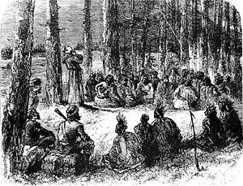
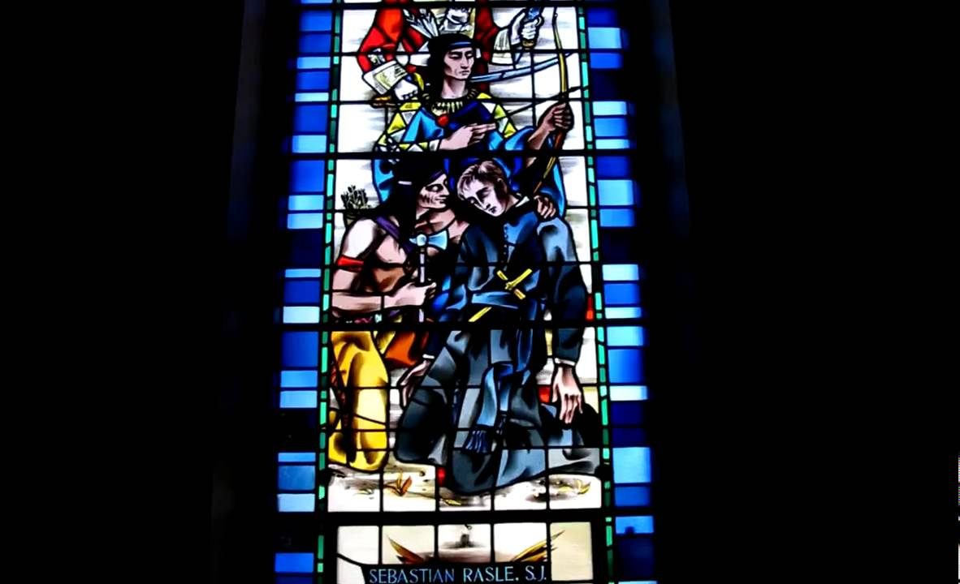
In fact, these missions were so odious to the English that they would often openly attack the Jesuit priests themselves. One priest, Father Rasles, had a price on his head and morning the English and a group of their Indian allies attacked the settlement at Norridgewock. According to “The Jesuit Relations: Natives and Missionaries in Seventeenth-Century North America”:

Slide 11
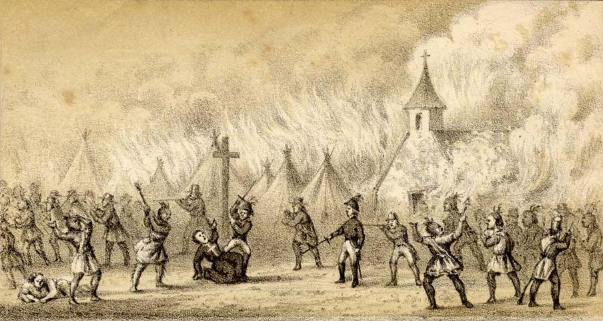
“Father Rasles, warned by the clamor and tumult, promptly left his house and fearlessly appeared before the enemy. He expected his presence to either stop the first efforts or at least draw the attention towards himself alone. As soon as they perceived the missionary a general shout was raised which was followed by a volley of musket shots that poured upon him. He dropped dead at the foot the large cross the he had erected in the midst of the village.”
Notes:
Divide students into two groups. One group is to discuss and form arguments on the topic of: The King of France was right to use the Jesuit missionaries to further the cause of French settlement in North America. The other group is to discuss and form arguments on: The King of France should not have expected the Jesuits missionaries to help in the French settlements in North America.
Reconvene the class and conduct a class debate on whether or not King Louis XIV should’ve used Jesuit missionaries to enhance France acquire more territory in North America.

Slide 12
THE BRITISH
The British point of view concerning the war:
Land is opportunity--The British colonies in America are growing fast, and to them, land means wealth and opportunity. British settlers want to settle the Ohio Valley, and seek more farmland, in addition to lucrative trade with the Indians.

Slide 13
We, the Commissioners of your Majesty’s Treasury beg leave humbly to present to your Majesty that having taken into consideration the present state of the duties of customs imposed on your Majesty’s subjects in America and the West Indies, we find that the revenue arising therefrom is very small and inconsiderable, … and is not yet sufficient to defray a fourth part of the expense necessary for collecting it. We observe with concern that through neglect, connivance, and fraud, not only is revenue impaired, but the commerce of the colonies diverted from its natural course… [This revenue] is more indispensable when the military establishment necessary for maintaining these colonies requires a large revenue to support it, and when their vast increase in territory and population makes the proper regulation of their trade of immediate necessity
What is the driving economic force behind British interest in the American colonies?

Slide 14
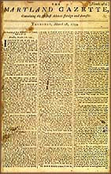
It is true Sir, that I have… expressed an Inclination to serve the ensuing Campaigne as a Volunteer, and this inclination is not a little increased since it is likely to be conducted by a Gentleman of the General’s Experience. But, besides this and the laudable desire I may have to serve (with my best abilities) my King & Country, I must be ingenuous enough to confess, that I am not a little biased by selfish considerations. To be plain, Sir, I wish earnestly to attain some knowledge of the Military Profession: and, believing a more favourable opportunity cannot offer, than to serve under a Gentleman of General Braddock’s abilities and experience.
George Washington, letter to Robert Orme, aide-de-camp to General Edward Braddock, March 15, 1755
Where does G. Washington’s loyalty reside during the onset of this conflict?
Notes:
The translation of this document can be found at: https://www.varsitytutors.com/earlyamerica/milestone-events/george-washingtons-journal-text

Slide 15
COLONISTS/AMERICANS
Colonists/American POV
Settlers want to move west--American colonists are fighting the French and Indian War partly for the right to settle in the disputed Ohio country. Settlers fear captivity, settlers in the backcountry fear captivity at the hands of the Indians. Some vigilantes, like the Paxton Boys, feed into rumors about Indian savagery and attack Indian villages - further fueling the war.

Slide 16
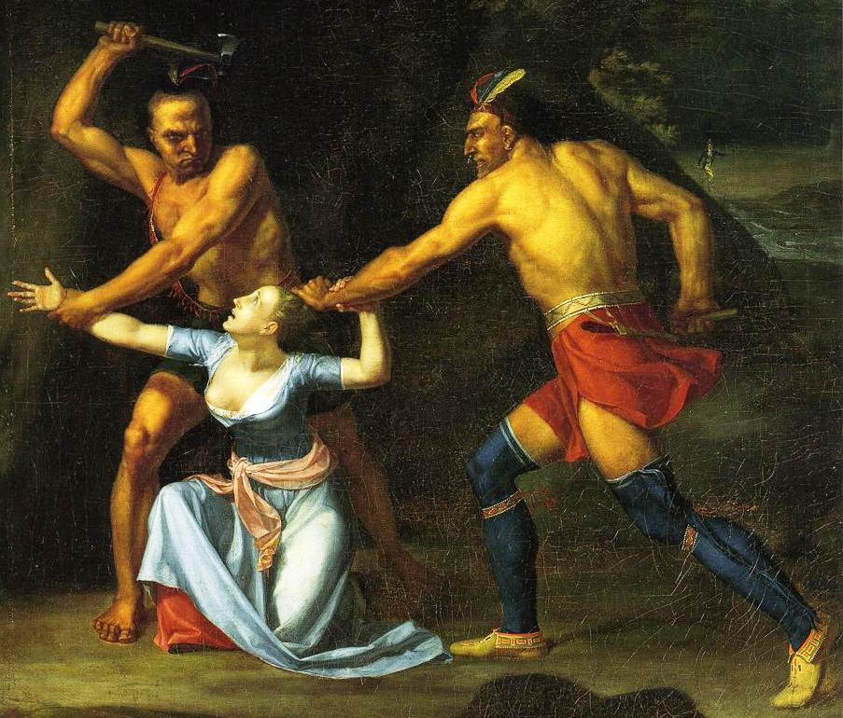
Mary Jemison recalling, in 1824, her capture by Indians during the French and Indian War
When we set off, an Indian in the forward canoe took the scalps of my former friends, strung them on a pole that he placed upon his shoulder, and in that manner carried them, standing in the stern of the canoe directly before us, as we sailed down the river....
On the way we passed a Shawnee town, where I saw a number of heads, arms, legs, and other fragments of the bodies of some white people who had just been burned....

Slide 17
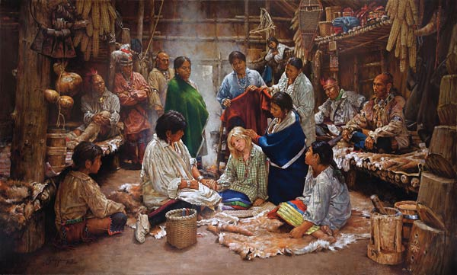
It was my happy lot to be accepted for adoption. At the time of the ceremony I was received by the two squaws to supply the place of their brother in the family; and I was ever considered and treated by them as a real sister, the same as though I had been born of their mother.

Slide 18
Massachusetts soldier’s diary, 1759.
September 30. Cold weather is coming on apace, which will make us look round about us and put [on] our winter clothing, and we shall in need of good liquors [in order] to keep our spirits on cold winter’s days. And we, being here within stone walls, are not likely to get liquors or clothes at this time of the year; and though we be Englishmen born, we are debarred [denied] Englishmen’s liberty. Therefore we now see what it is to be under martial law and to be the [British] regulars, who are but little than slaves to their officers. And when I get out of their [power] I shall take care how I get in again.
October 31. And so now our time has come to an end according to enlistment, but we are not yet [allowed to go] home.
November 1. The regiment was ordered out… to hear what the colonel had to say to them as our time was out and we all swore that we would do no more duty here. So it was a day of much confusion with the regiment.
How did the conflict create tension between colonial militiamen and British troops?

Slide 19
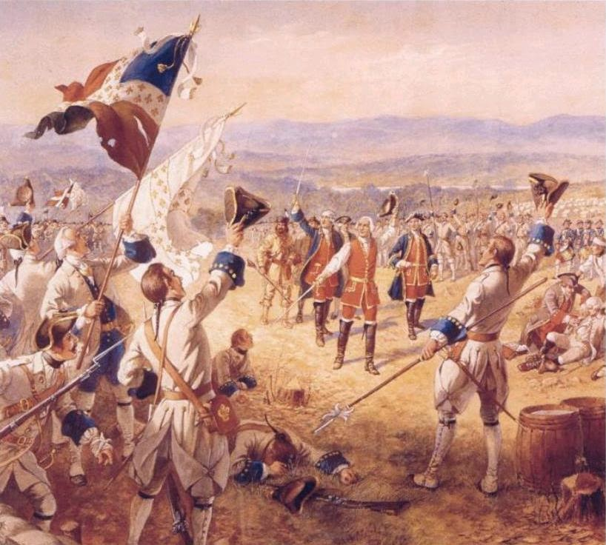
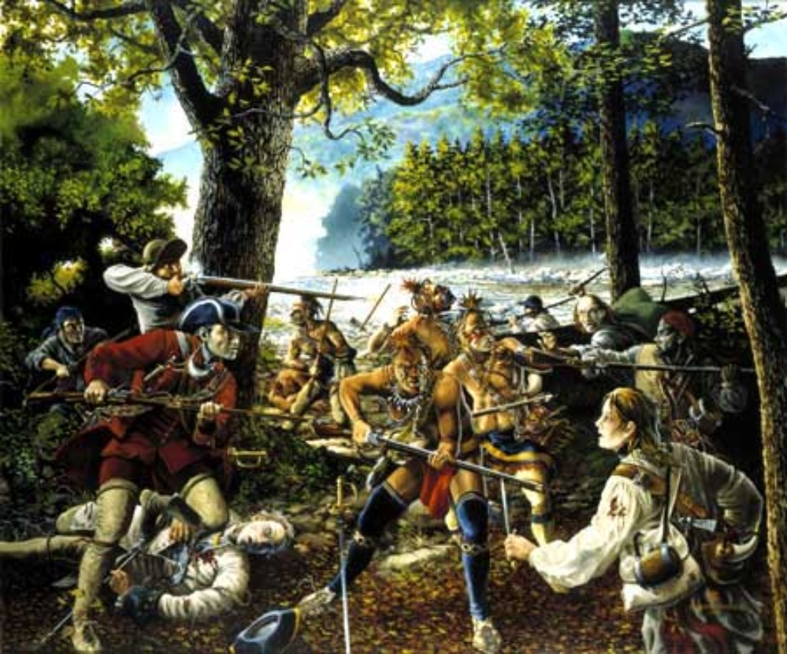
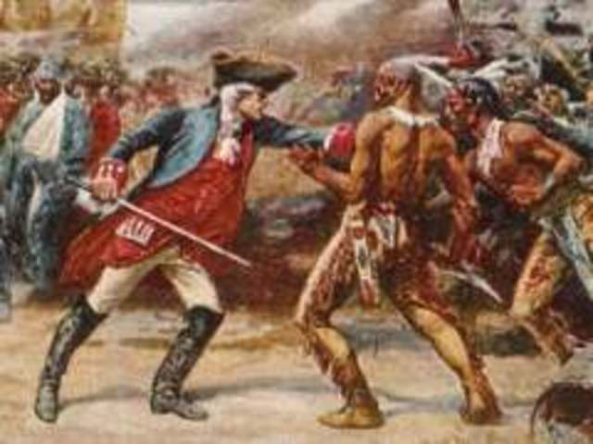
Chronology of the battles of the French and Indian War

Slide 20
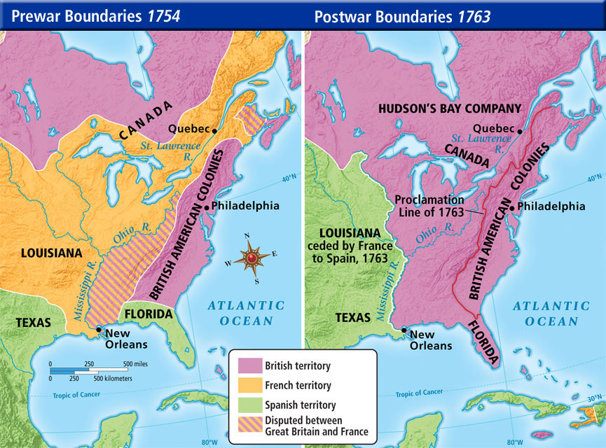
Notes:
Students complete the map analysis worksheet from https://www.archives.gov/files/education/lessons/worksheets/map_analysis_worksheet.pdf

Slide 21
1. Without knowing the title of this painting, how would you describe the event that happened in this scene? Defend your answer. 2. Describe how you feel when you see this image. 3. What type of atmosphere is created through the artist’s choice in colors in this work? 4. What groups of people are depicted in the painting? 5. What are some characteristics that define the different groups?
Notes:
The Death of General Wolfe by Benjamin West, circa 1770

Slide 22
The outcomes of the French and Indian War:
THE BRITISH:
it meant a great expansion of British territorial claims in the New World.
the cost of the war had greatly enlarged Britain's debt.
the war generated substantial resentment towards the colonists
THE AMERICAN COLONISTS:
the colonists had learned to unite against a common foe.
now they had seen that together they could be a power to be reckoned with
the next common foe would be Britain.

Slide 23
THE FRENCH:
Were forced to surrender all of her American possessions to the British
Ended French influence in America
The military defeat and the financial burden of the war weakened the monarchy and contributed to the advent of the French Revolution in 1789.
THE NATIVE AMERICANS:
earned the enmity of the victorious English.
were never again in a position to deal with their white rivals on terms of military or political equality.

Slide 24
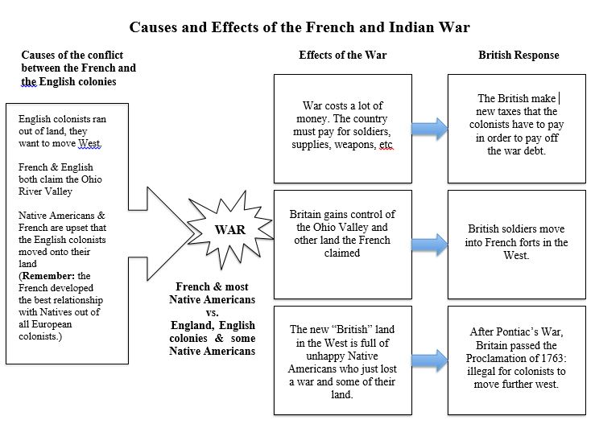

Slide 25
The War's over! As a colonist, tell us how you feel about the British, the French, and the Native Americans and why.
You are composing a letter to your family in Italy. In your letter you must explain to your family:
The four groups involved and why they are involved the conflict.
How the layout (geography) of the land contributed to the conflict.
The outcomes of war.

